Slide 1
Why We Must Ask Why of Machine Learning
interpretability and explainability of machine learning models and why that matters

Slide 2



Introduction
Stephen (Steve) Newman
Principal Software Engineer
Common Cloud Platform on AVEVA Connect
/newmancodes
/newmancodes
newman.digital

Slide 3
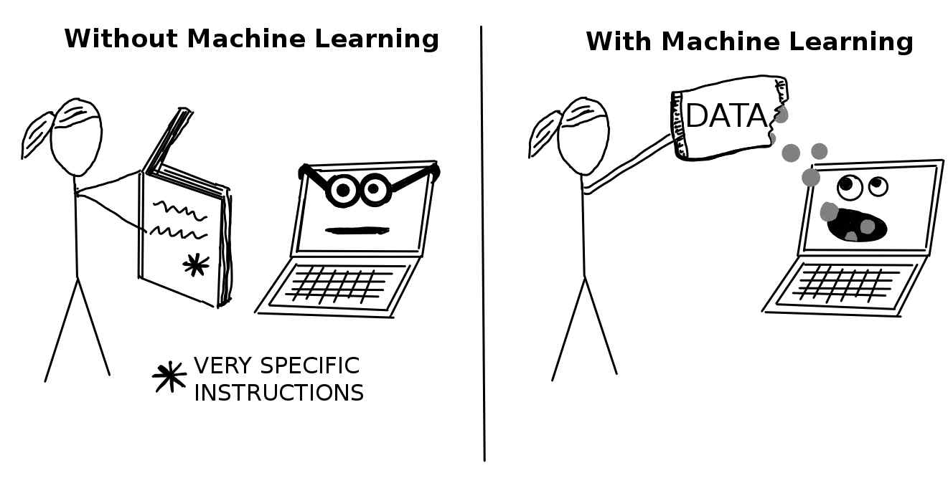
What is Machine Learning?
Supervised
Unsupervised
Semi-Supervised
Reinforcement
christophm.github.io
Notes:
A sub-field of Artificial Intelligence
Supervised learning involves data that is labelled in some way
Classification – assign data to categories
Regression – find relationships between independent and dependent values where the output is a continuous value e.g.
Unsupervised learning involves no labelled data
Clustering – put similar things together
Association – find relationships, good for recommendation engines
Dimensionality Reduction – reduce the number of features in a dataset without harming integrity
Semi-supervised learning has a small amount of labelled data and large amount of unlabelled data
Reinforcement
Reward or punish the AI to encourage/discourage behaviour
Instead of specific instructions that represent the rules to the machine
We provide this data and the machine attempts to derive the rules from the dataset

Slide 4

What is in a Model?
Model is some predictor ƒ(x)
Model may be looking at the wrong thing
Some models are proprietary
Some models are too complex to understand
Notes:
Models are trained to consume input and make a prediction or take some action
Can obtain very high accuracy levels
But are not perfect and should not be blindly trusted
Researchers in 2018 found that a CNN could look at the wrong thing
During training an AI recognised that portable scans were stamped as such
The model found a correlation between portable scans and pneumonia likelihood and began looking for the portable stamp rather than evidence of pneumonia
Organisations attempting to sell their model are disincentivised from making too much public
How and with what were the model trained, what is their internal configuration, what are the weights
Humans are limited as to how much they can hold in their brains at once 7±2
Some models are incredibly complex to the point where the become impenetrable

Slide 5
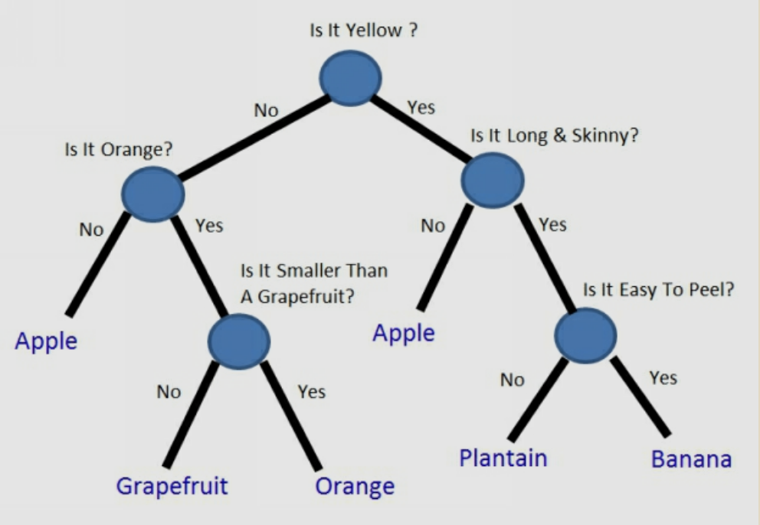
Enter Explainable AI
Not a new concept
Not solved
Language is not always consistent
Of increasing importance
Notes:
Expert Systems developed in the 70s and 80s discovered a need for explainability
Both to aid system development and the grow user trust
An active area of research within the AI community
Mixture of terms being used within the XAI umbrella
Interpretability – a model is inherently understandable by a domain expert
Explainability – a mechanism by which a prediction reason (or semi-reason) can be extracted
Increasing Importance
EU Artificial Intelligence Act reached draft proposal in April 2021
Italy banning the use of Chat-GPT over privacy concerns
Organisations are building products to aid in this space (e.g. IBM’s AI Explainability 360 toolkit)
From estimated $3.5bn in 2020 to $21bn by 2030 (Research Markets Nov. 2021)

Slide 6

XAI Stakeholders
Developers
Users
Theorists
Ethicists
Notes:
Developers
System Testing
Debugging
Evaluating Results
Users
Should I act based on this prediction
How do I justify my action
Do I trust this outcome
Theorists
Mostly academics and researchers
Pushing the boundaries
May be more interested in models being easier to understand rather than explain outputs
Ethicists
Interested in Fairness, Accountability, and Transparency of AI systems
Wide section of society
Regulators, Legislatures

Slide 7
XAI Flavours
Interpretability
Transparent
Domain Expert
Explainability
Opaque
Highlight Parts of Input that Matter
Companion Predictor

Slide 8
MNIST Example
ML “Hello, World!”
Supervised Learning
Handwritten Digit Classification
70,000 28x28 greyscale handwritten digits
CNN
>99% Accuracy
32 3x3 Convolutional
2x2 Max Pooling
64 3x3 Convolutional
2x2 Max Pooling
Flatten
Dropout
Dense
34,826 Trainable Params
Notes:
60,000 in the training set
10,000 in the test set
32 filters, each of them with size 3x3 – 1 param for each of the filter cells – 9 per filter applied to the 1 dimension we have plus a bias = this layer has 9x32x1+32 parameters (320)
Max pooling 2x2 takes our 26x26x32 result and shrinks each result – 13x13x32
64 filters, each of them with size 3x3 – 1 param for each of the filter cells, plus a bias – 9 per filter applied to the 32 dimensions we have plus a bias = this layer has 9x64x32+64 parameters (18,496)
Max pooling 2x2 takes out 11x11x64 results and shrinks each result – 5x5x64
Flatten layer results in 5x5x64 neurons in this layer – 1,600 neurons
Dropout layer doesn’t affect the shape – 1,600 neurons
Dense layer connects each of the 1,600 to the output 10 neurons (1 per digit in the classification target 0-9), plus a bias for each – 16,010 parameters
So a total of 34,826 trainable parameters
While we “could” do the mathematics here to generate the correct result, not sure it would tell us anything – we’d just be doing by hand what the ML model is doing for us
We need some way of visualising what the model cares about

Slide 9

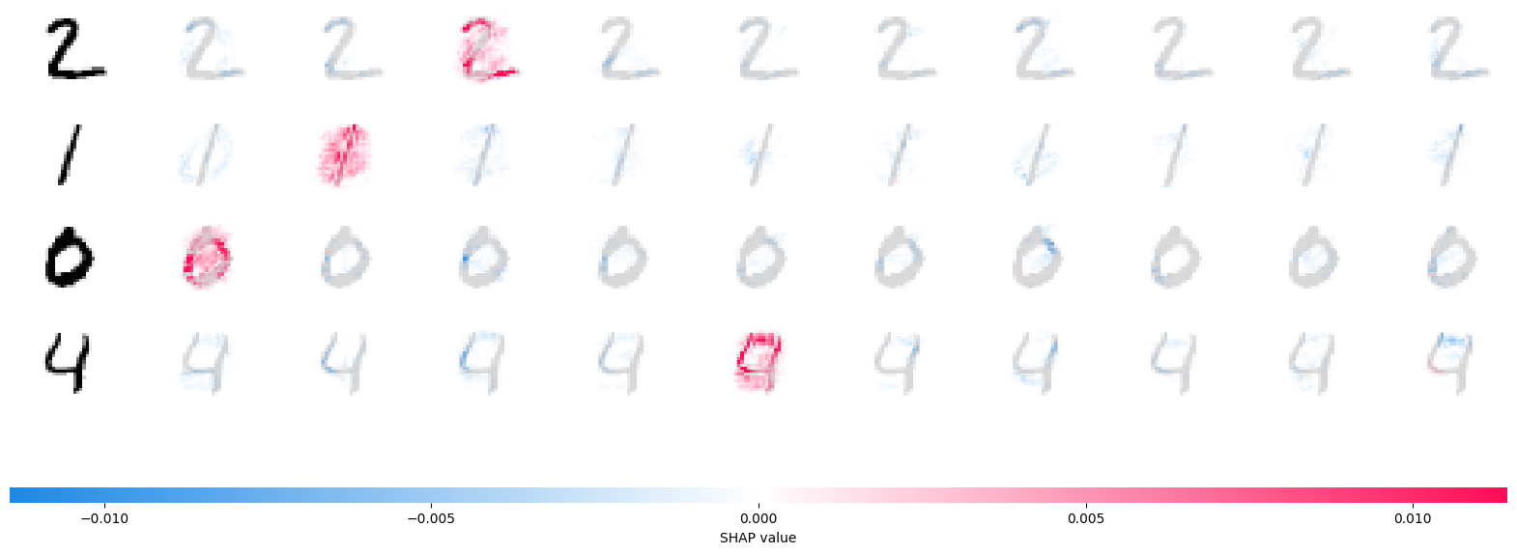

Shapely Values
Contribution of each player
Positive or negative effect
Notes:
We can think of each pixel in our 28x28 image is a player
The more red a “player” is, the more it contributed to this classification
The more blue a “player” is, the more it dissuaded from this classification
Here we can see our zero has red in the middle – the fact that those “players” were not set, meant it was more likely to be a zero, similarly the blue in the centre of the 8 signifies that as these players were not set, it’s less likely to be an eight
Similarly with our four. The fact that the top was closed moves the prediction away from a nine and towards a four

Slide 10
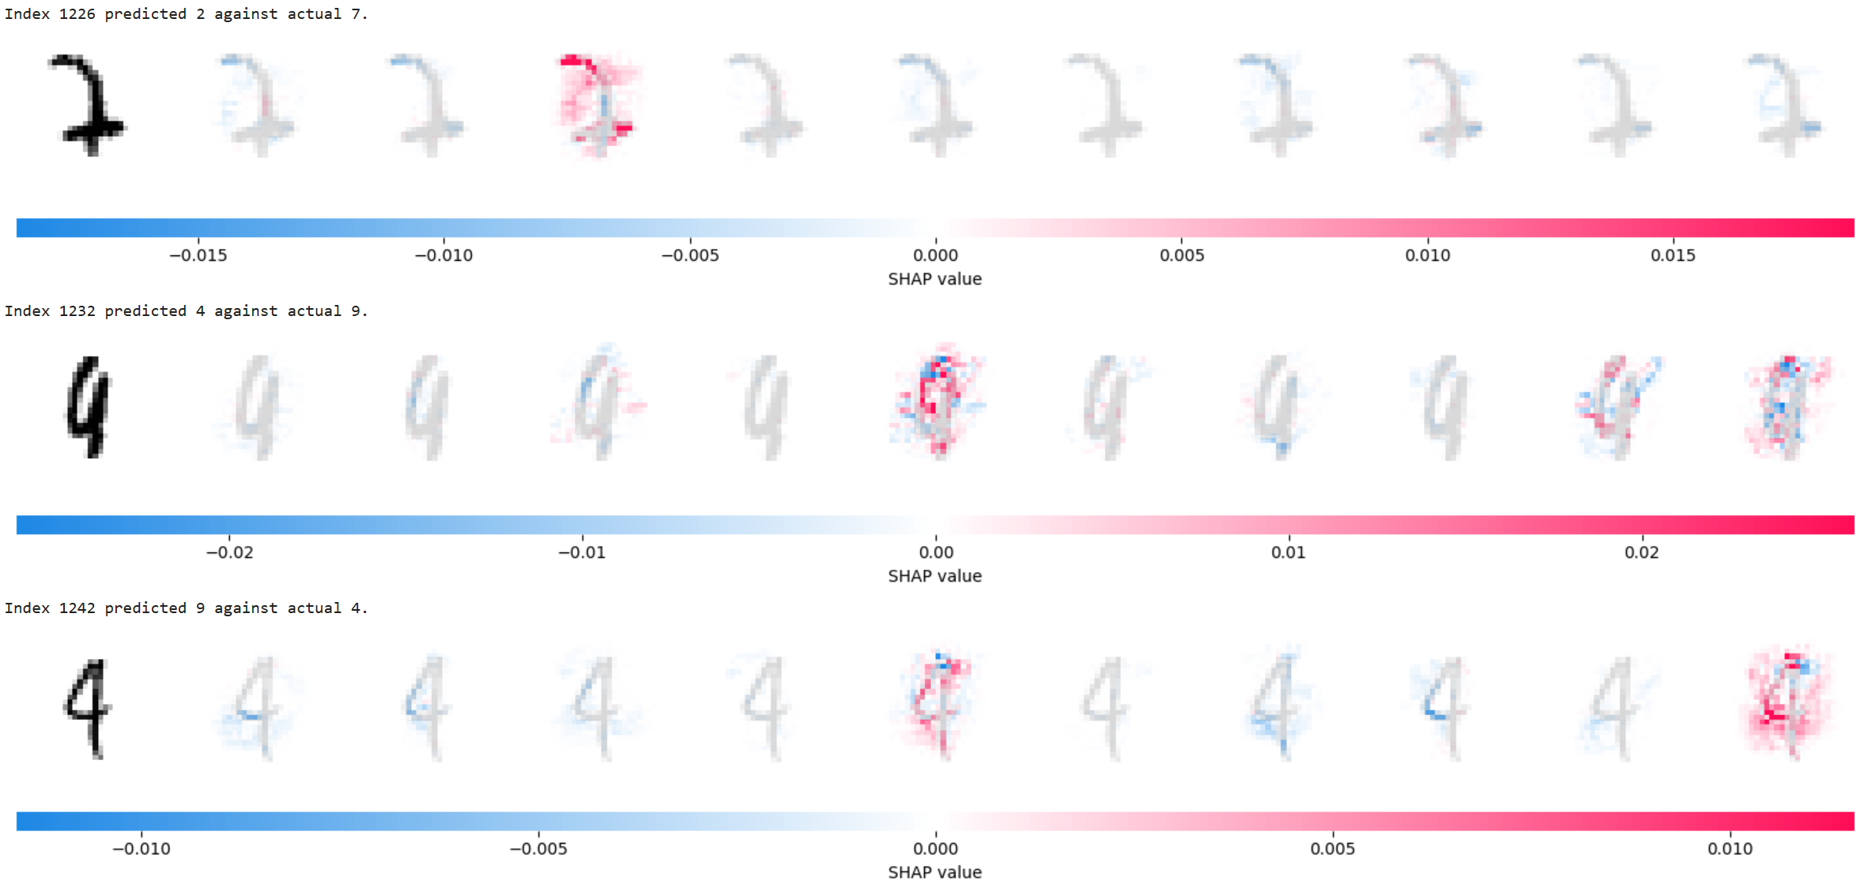
When The Model Is Wrong
Notes:
Here are some instances from the test set which the model mis-classifies
This explainer shows us which parts of the image the model found more compelling for each classifier
But doesn’t offer any guidance as to how we can improve the classifier
Could still be useful when responding the challenges

Slide 11

Is This Always Necessary?
Is the problem considered solved?
How High Risk is the domain?
Consider different stakeholder viewpoints
Consider the passing of time
Notes:
The MNIST example is sufficiently basic that it may not need much in the way of XAI
But if the domain we are applying AI is novel, then they may skew us towards wanting to get a view as to how the model is working
If the domain is higher risk e.g. breast cancer samples being classified as benign or malignant, recommending repair or replacement of valves in an industrial setting
If the model is wrong, we may elect to pessimistically classify a mass or the state of a component
We would likely be pulled towards supplying an interpretable or explainable model for such high risk domains
But perhaps less so for recommendation engines
However, even for scenarios which feel low risk, we cannot necessarily ignore XAI
For example, if a content platform’s recommendation engine is found to biased this can affect the monetisation potential of a content creator
But it’s possible the content consumer is less concerned
In the recent Payment Protection Insurance scandal in the UK
Financial institutions had to provide evidence that they had not mis-sold PPI
What if a ML model had taken part in that decision?

Slide 12
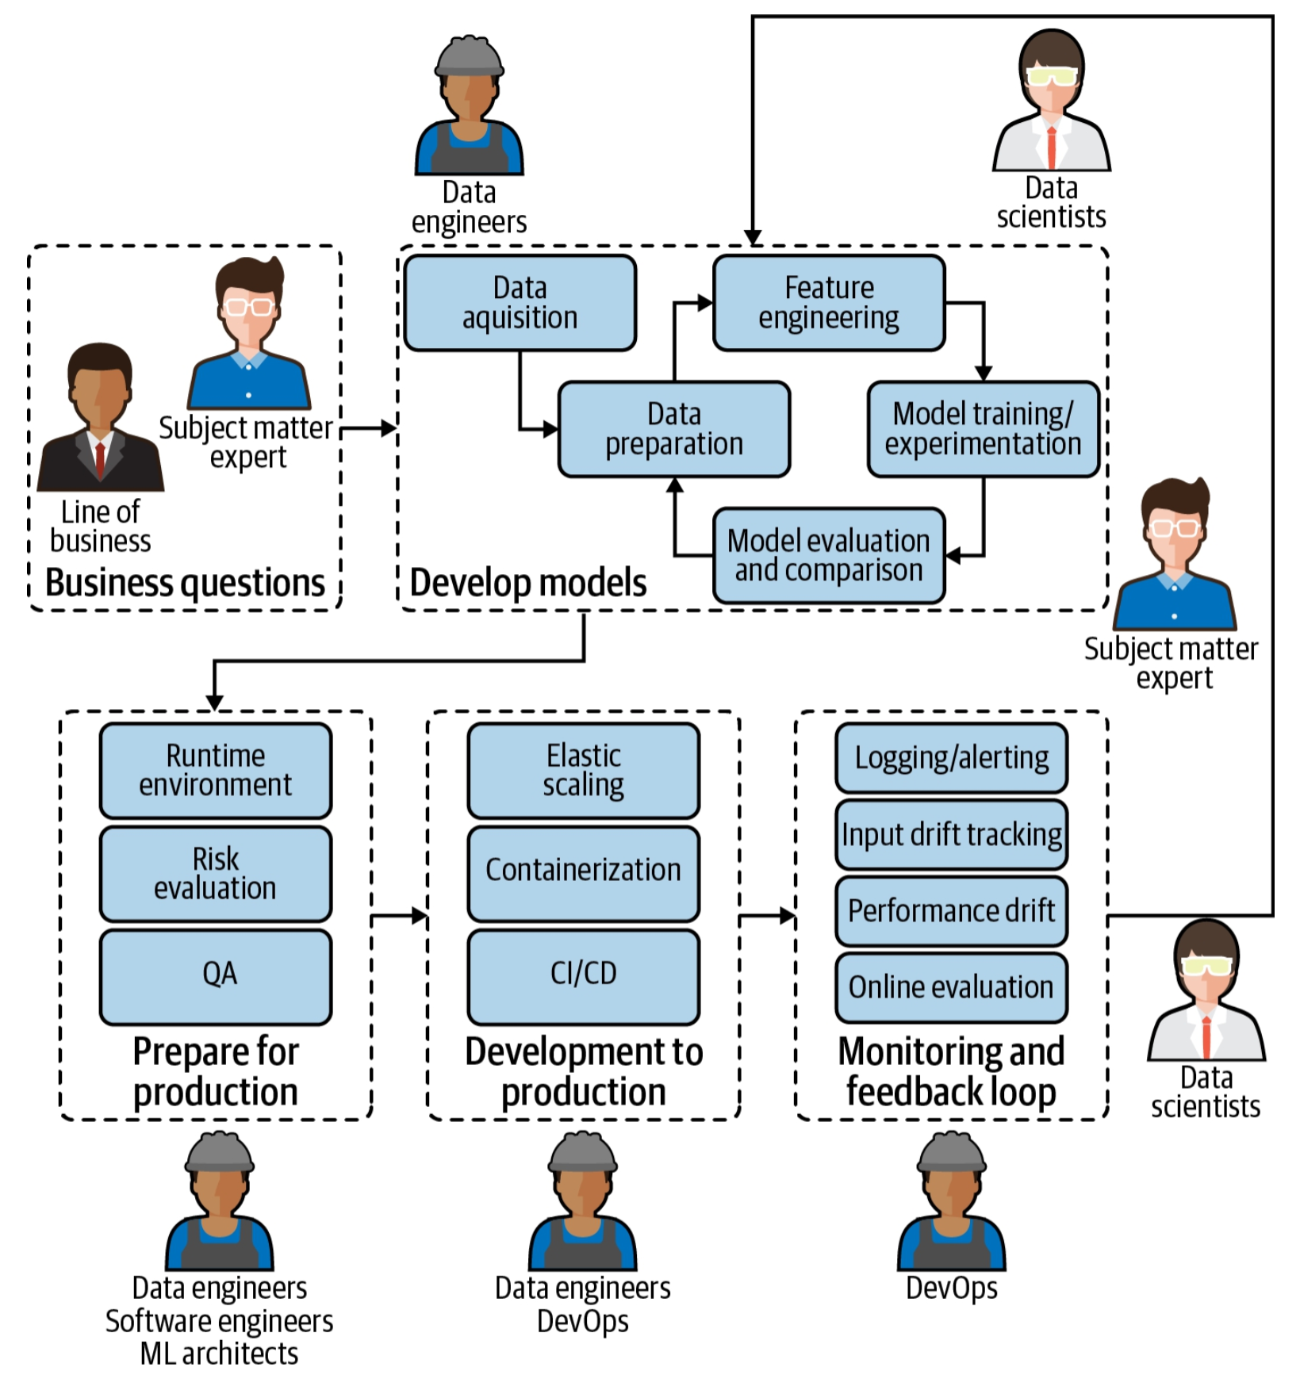
MLOps
Similar to DevOps, DevSecOps etc.
Introducing MLOps - O'Reilly
Notes:
Emerging set of best practices around productionising ML
Forms a feedback loop which can trigger to need to train a new model
For example, over time a model may cease to be sufficiently generalised as the novel data moves away from the training data
This should trigger the model be evolved or a new model be developed
Future requests from XAI stakeholders may mean we need to be able to explain a historic model outcome
Do we capture enough to be able to do that?
Do we record the model outcome and it’s explainer outcomes?

Slide 13
Take Aways
Don’t blindly believe AI
Identify and Communicate XAI needs
Transparent > Opaque
MLOps pipeline
Ask model vendors about interpretability and explainability
Notes:
Be alert to AI not always getting it right
Determine what XAI needs your specific scenario has
Favour transparent over opaque models if possible
Remember that your machine learning pipeline may need to produce extra artifacts (e.g. explainers)
When buying models in, ask the vendor how they have met the explainability challenge

Slide 14
Questions?
https://tinyurl.com/4ef4hmfs

